Slide 1

Unit 2.2:
Data Structures I
Utrecht Summer School:
Programming with Python 2023
All icons by: https://www.flaticon.com/

Slide 2
Data Structures in Python

Slide 3
Previous data types
Atomic:
  int (7)
  float (2.5)
  bool (False)
Collections:
  str (“apple”)

Slide 4
str as a collection
“apple” = “a”, “p”, “p”, “l”, “e”

Slide 5
str as a collection
“apple” = “a”, “p”, “p”, “l”, “e”
len(“apple”) → 5
len(5) → TypeError

Slide 6
Lists
myList = [1,3,True,6.5]

Slide 7
Lists
myList = [1,3,True,6.5]
Ordered → [1,2] ≠ [2,1]

Slide 8
Lists
myList = [1,3,True,6.5]
Ordered → [1,2] ≠ [2,1]
Mutable →
  myList[1] = 5
  print(myList) → [1,5,True,6.5]

Slide 9
Lists
myList = [1, 3, True, 6.5]
Ordered → [1, 2] ≠ [2, 1]
Mutable →
  myList[1] = 5
  print(myList) → [1, 5, True, 6.5]
Non-unique → [1, 1, True, 6.5]

Slide 10
Lists
myList = [1, 3, True, 6.5]
Iterable →
  for el in myList:
  print(el)
  → 1
  3
  True
  6.5

Slide 11
Operations on lists
myList = [4, 1]
Name | Operator | Example
Indexing | [] | myList[0] → 4
Concatenation | + | myList + [2] → [4, 1, 2]
Repetition | * | myList * 2 → [4, 1, 4, 1]
Membership | in | 1 in myList → True
Length | len | len(myList) → 2
Slicing | [:] | myList[1:2] → [1]

Slide 12
Functions for lists
myList = [4, 1]
Name | Use | Returns | myList after
append | myList.append(2) | None | [4, 1, 2]
insert | myList.insert(0, 2) | None | [2, 4, 1]
pop | myList.pop(0) | 4 | [1]
sort | myList.sort() | None | [1, 4]
reverse | myList.reverse() | None | [1, 4]
index | myList.index(4) | 0 | [4, 1]
count | myList.count(1) | 1 | [4, 1]
remove | myList.remove(4) | None | [1]

Slide 13
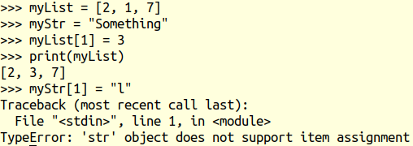
Mutability

Slide 14
Tuples
Ordered

Slide 15
Tuples
Ordered
Immutable

Slide 16
Tuples
Ordered
Immutable
Non-unique

Slide 17
Tuples
Ordered
Immutable
Non-unique
Iterable

Slide 18
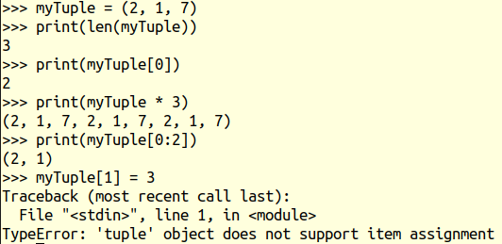
Tuples

Slide 19


Slide 20
1-minute paper
lists, sets, mutability
Notes:
Take 2 minutes for this

